Slide 1
Classical Conditioning Theory
Class- BA 1st Year. By –Preety
^{Assistant of Professor}
^{Department of Psychology}
^{Kanya mahavidyalaya}

Slide 2
Learning
“Learning is defined as any relatively permanent change in behavior, which is due to experience or practice.“
Learning involves change in behavior.
Change is due to experience or practice.
The change must last for a fairly long time.

Slide 3
Classical Conditioning Theory
Classical conditioning was the first type of learning to be discovered and studied within the behaviorist tradition. Conditioning is a kind of response build up through repeated exposure.
The major theorist in the development of classical conditioning is Ivan Pavlov, a Russian scientist trained in biology and medicine .

Slide 4
Classical Conditioning Theory
Pavlov was studying the digestive system of dogs and became intrigued with his observation that dogs deprived of food began to salivate when one of his assistants walked into the room. He began to investigate this phenomena and established the laws of classical conditioning.

Slide 5
Classical Conditioning
Classical conditioning is a learning process that occurs through associations between an environmental stimulus and a naturally occurring stimulus. It had a major influence on behaviorism which is based on the assumption that learning occurs through interactions with the environment.

Slide 6
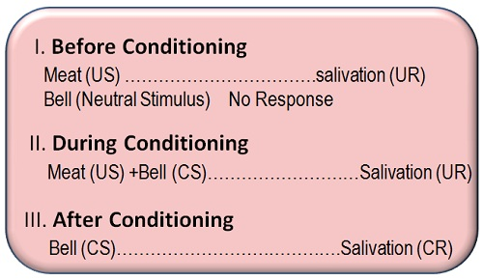

Slide 7
Components of Classical Conditioning
The Unconditioned Stimulus (US) :A stimulus that naturally, and automatically triggers a response.
The Unconditioned Response(UR):The unlearned response that occurs naturally in response to the unconditioned stimulus.
The Conditioned Stimulus(CS):A previously neutral stimulus that when paired with an unconditioned stimulus triggers a conditioned response.

Slide 8
Components of Classical Conditioning
The Conditioned Response(CR):Learned response to the previously neutral stimulus.

Slide 9
Principles of Classical Conditioning
Acquisition.
Extinction.
Spontaneous Recovery.
Stimulus Generalization.
Discrimination

Slide 10
Types of Conditioning
Forward conditioning: During forward conditioning the onset of the CS precedes the onset of the US. Two common forms of forward conditioning are delay and trace conditioning.
Delay Conditioning: In delay conditioning the CS is presented and is overlapped by the presentation of the US.

Slide 11
Types of Conditioning
Trace conditioning: During trace conditioning the CS and US do not overlap. Instead, the CS is presented, a period of time is allowed to elapse during which no stimuli are presented, and then the US is presented. The stimulus free period is called the trace interval .
Simultaneous conditioning: During simultaneous conditioning, the CS and US are presented and terminated at the same time.

Slide 12
Types of Conditioning
Backward conditioning: Backward conditioning occurs when a conditioned stimulus immediately follows an unconditioned stimulus. Unlike traditional conditioning models, in which the conditioned stimulus precedes the unconditioned stimulus, the conditioned response tends to be inhibitory. This is because the conditioned stimulus serves as a signal that the unconditioned stimulus has ended, rather than a reliable method of predicting the future occurrence of the unconditioned stimulus

Slide 13


